Slide 1



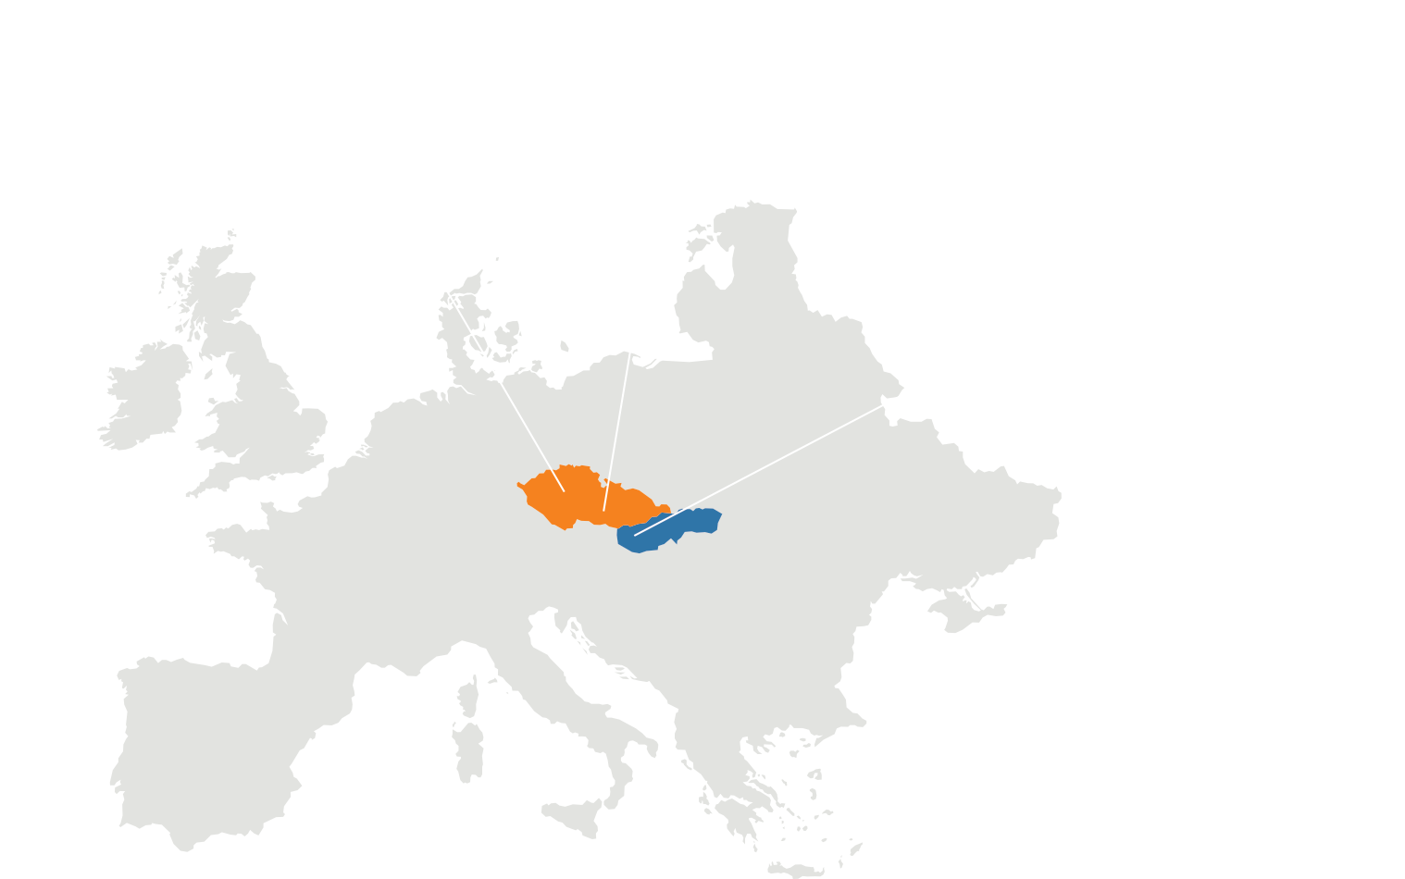




ERP
CRM
BI
Part 3 – What we learnt with AL Development
DMS
Christiaan Versfeld & Tiffany Elias
Software Developers
05. 05. 2025
AI
34
37

Slide 2
ERP
Table of Contents
Part 1 – Theoretical Fundamentals (Tiffany)
What is AL & its purpose?
Objects in AL
Development Lifecycle in AL
Testing in AL (Basics)
AL Compared to other languages
Part 2 – Practical Fundamentals (Christiaan)
System background
Core system features & Functions
Codeunits and logic
Demo
Challenges & Lessons
Part 3 – Wrap-Up and future Ideas (Both)
Expansion plans (if continued)
Challenges we faced during project cycle
What we learnt with AL Development
Q&A’s
CRM
BI
DMS
AI
34
37

Slide 3
ERP
CRM
BI
Part 1 – What is AL & its purpose?
DMS
Tiffany Elias
Software Developer
05. 05. 2025
AI
34
37

Slide 4
ERP
CRM
BI
Part 1 – Objects in AL
DMS
Tiffany Elias
Software Developer
05. 05. 2025
AI
34
37

Slide 5
ERP
CRM
BI
Part 1 – Development Lifecycle in AL
DMS
Tiffany Elias
Software Developer
05. 05. 2025
AI
34
37

Slide 6
ERP
CRM
BI
Part 1 – Testing in AL (Basics)
DMS
Tiffany Elias
Software Developer
05. 05. 2025
AI
34
37

Slide 7
ERP
CRM
BI
Part 1 – AL Compared to other languages
DMS
Tiffany Elias
Software Developer
05. 05. 2025
AI
34
37

Slide 8
ERP
CRM
BI
Part 2 – System Background
DMS
Christiaan Versfeld
Software Developer
05. 05. 2025
AI
34
37

Slide 9
ERP
CRM
BI
Part 2 – Core system features & Functions
DMS
Christiaan Versfeld
Software Developer
05. 05. 2025
AI
34
37

Slide 10
ERP
CRM
BI
Part 2 – Codeunits and logic
DMS
Christiaan Versfeld
Software Developer
05. 05. 2025
AI
34
37

Slide 11
ERP
CRM
BI
Part 2 – Challenges & Lessons
DMS
Christiaan Versfeld
Software Developer
05. 05. 2025
AI
34
37

Slide 12
ERP
CRM
BI
Part 3 – Expansion plans (if continued)
DMS
Christiaan Versfeld & Tiffany Elias
Software Developers
05. 05. 2025
AI
34
37

Slide 13
ERP
CRM
Part 3 – Challenges we faced during project cycle
BI
DMS
Christiaan Versfeld & Tiffany Elias
Software Developers
05. 05. 2025
AI
34
37

Slide 14
ERP
CRM
Part 3 – Challenges we faced during project cycle
BI
DMS
Christiaan Versfeld & Tiffany Elias
Software Developers
05. 05. 2025
AI
34
37

Slide 15
ERP
CRM
BI
Part 3 – Q&A’s
DMS
Christiaan Versfeld & Tiffany Elias
Software Developers
05. 05. 2025
AI
34
37

Slide 16


